Slide 1
Spring Cloud
Xiaolong Tang
Feb, 2018

Slide 2
微服务
The microservice architectural style is an approach to developing a single application as a suite of small services, each running in its own process and communicating with lightweight mechanisms, often an HTTP resource API.

Slide 3
Spring Cloud
Spring Cloud 就是一系列的组件，每个组件其实就是把已有的一些框架封装到spring boot 中，通常在spring boot中只需要加上注解和配置就可以启动这些框架
Spring Cloud 的组件是可以让spring boot组成集群，达到微服务架构

Slide 4
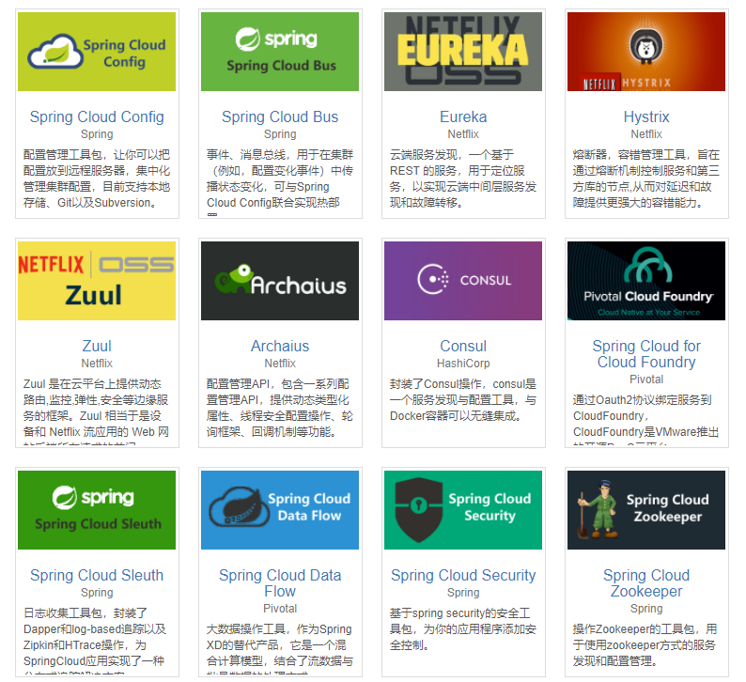
Spring Cloud
https://springcloud.cc/

Slide 5
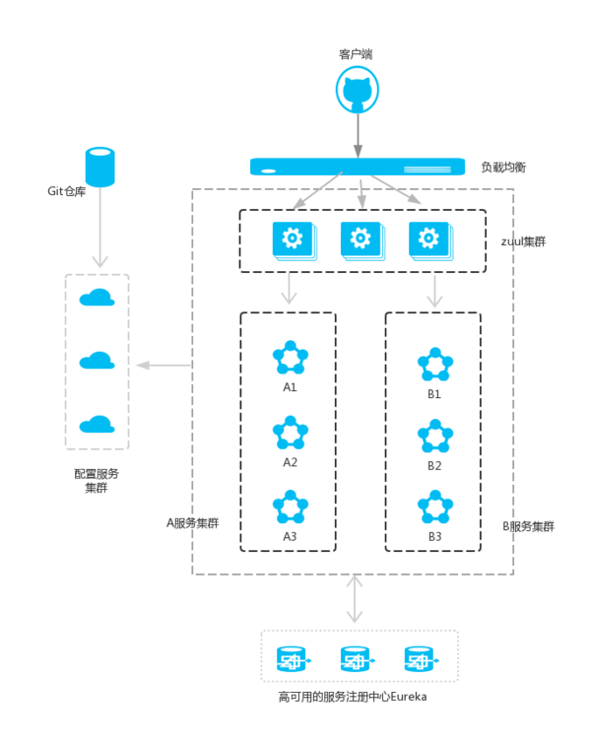
Spring Cloud

Slide 6
Spring Cloud – Eureka Server
@EnableEurekaServer
Application.properties进行配置
Dashboard link 是http://hostname:port/eureka/

Slide 7
Spring Cloud – Eureka Client
@EnableEurekaClient
Application.properties进行配置

Slide 8
Spring Cloud – Feign
@EnableFeignClients
@FeignClient(value = “SERVICE-NAME")

Slide 9
Spring Cloud – Hystrix
Feign含有Hytrix框架
feign.hystrix.enabled=true
@FeignClient(value = “SERVICE-NAME")
fallback =实现类.class

Slide 10
Spring Cloud – zuul
@EnableZuulProxy
ZuulFilter

Slide 11
Spring Cloud – zuul
@EnableZuulProxy
ZuulFilter

Slide 12
Spring Cloud – config-server
@EnableConfigServer
/{application}/{profile}[/{label}]
/{application}-{profile}.yml
/{label}/{application}-{profile}.yml
/{application}-{profile}.properties
/{label}/{application}-{profile}.properties

Slide 13
Spring Cloud – config-client
bootstrap.properties
Application name要等同于git仓中的文件名

Slide 14
Spring Cloud – cloud bus
@RefreshScope

Slide 15
Thanks!

